Slide 1
Entertainer Data Analytics
Insights into the careers of notable entertainers
Name: Puneet Surya Anem
Company: Unified Mentor Private Limited

Slide 2
Contents
01
02
03
Project Description
Data description
Dashboard Overview
04
05
Key Findings
Conclusion

Slide 3
Introduction
Overview:
This project aims to analyze the careers of entertainers using data science techniques to uncover trends and insights in the film and entertainment industry.
Objectives:
Understand trends in breakthrough years of entertainers
Analyze demographics and career timelines
Identify top entertainers based on various metrics

Slide 4
Project Description
Technologies: Python, Power BI
Domain: Data Science, Film and Entertainment
Difficulty Level: Intermediate
Problem Statement:
Entertainment is a vital part of life, reducing stress and providing enjoyment. The project analyzes various segments of the entertainment industry, including film, television, radio, and print.
Dataset: Available for download from the provided link

Slide 5
Data description & preprocessing
Key Columns:
Entertainer , Gender (traditional), Birth Year, Headshot, Year of Last Major Work (arguable), Year of Death, Year of Breakthrough/#1 Hit/Award Nomination, Breakthrough Name, Year of First Oscar/Grammy/Emmy
Source: Extracted using IMDbPY library and cleaned using Python
Python Code:
Used IMDbPY library to fetch headshots and other details
Created a list to store extracted data
Merged the data into the main dataset
Outcome: Clean dataset with enriched information

Slide 6
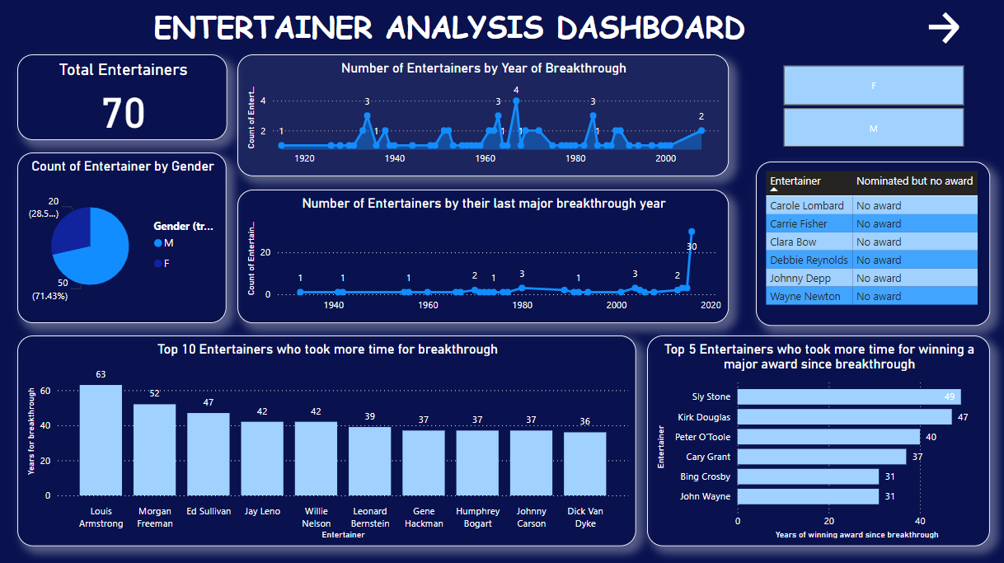
Dashboard Overview
Main dashboard components include:
Total Entertainers
Count of Entertainers by Gender
Number of Entertainers by Year of Breakthrough
Number of Entertainers with their Last Major Breakthrough
Top 10 Entertainers Who Took More Time for Breakthrough
Top 5 Entertainers Who Took More Time for Winning a Major Award Since Breakthrough

Slide 7
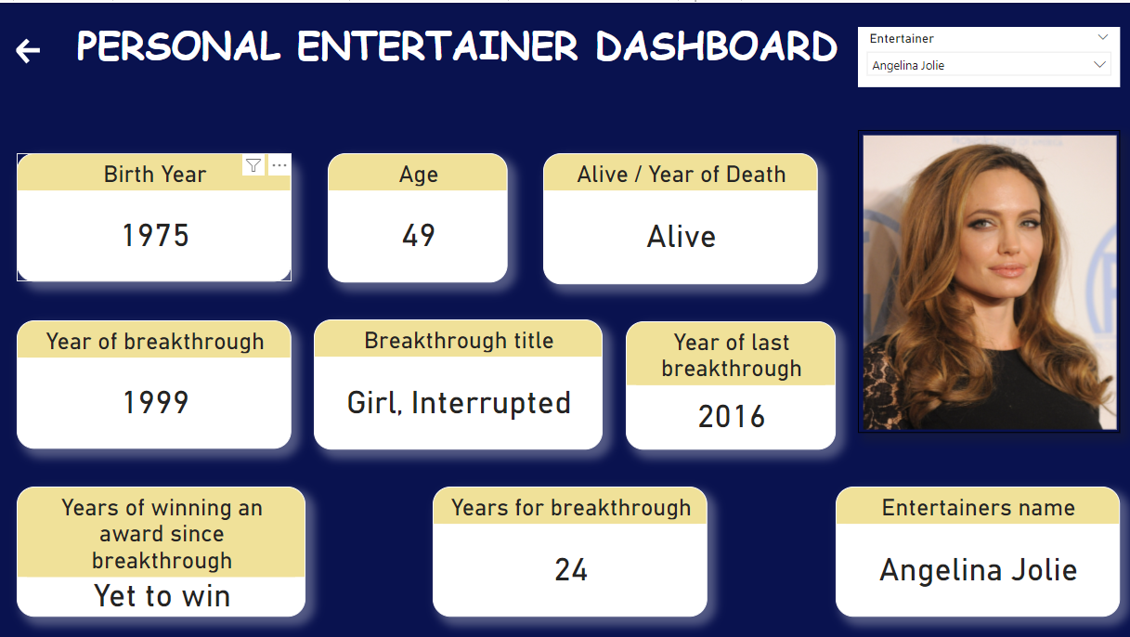
Personal Entertainer Dashboard
Insight:
Detailed insights into individual entertainers, such as Angelina Jolie, showing birth year, age, breakthrough year, and major achievements.
Observation:
Personalized view helps in understanding the career trajectory of individual entertainers.
It is dynamic dashboard which refreshes for each entertainer.

Slide 8
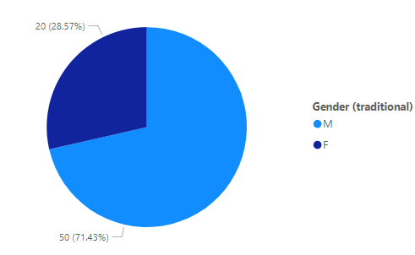
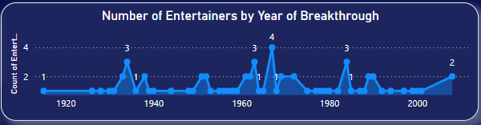
Key Findings
Total Entertainers:
Analyzed 70 entertainers, providing a comprehensive dataset for insights.
Gender Distribution:
Males: 50 (71.43%)
Females: 20 (28.57%)
Observation: Indicates a significant gender disparity in the entertainment industry.
Year of Breakthrough:
Peaks in certain years(1967 - 4, 1934 1963 1984 - 3) reveal periods with higher breakthrough rates.
Observation: Significant trends in industry events or external factors influencing these peaks.

Slide 9
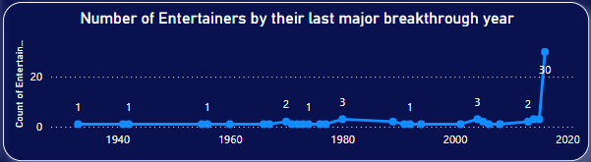
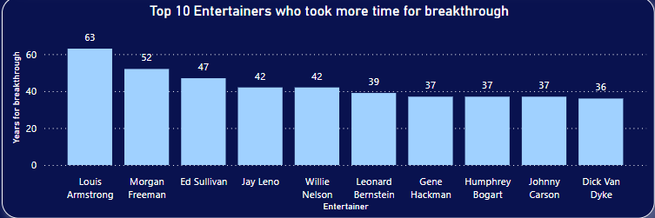
Last Major Breakthrough:
There has been constant major breakthroughs throughout the years, but 2016 alone have registered maximum number of 30 last best breakthroughs by the entertainers. Recent years show a decline in the number of entertainers achieving major breakthroughs.
Observation: Changes in the industry dynamics or emergence of new forms of entertainment.
Time for Breakthrough:
Longest Time: Louis Armstrong took 63 years for a breakthrough.
Observation: Highlights the persistence and longevity required for some entertainers to achieve recognition.

Slide 10
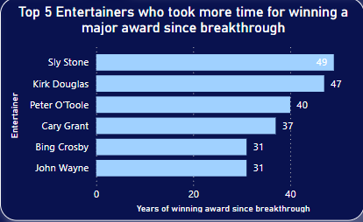
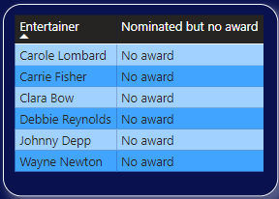
Time for Major Award:
Longest Time: Sly Stone took 49 years to win a major award since their breakthrough.
Observation: Showcases the varying timelines for achieving major accolades in the industry.
In our analysis there were few entertainers who were nominated for their performances but haven’t yet received any major award.
There are 6 entertainers among the 70. Out of 6 there are 4 female and 2 male out of which Legendary Johnny Depp is included.

Slide 11
Conclusion
The Entertainer Data Analytics project reveals significant insights into the entertainment industry, highlighting gender disparities, trends in breakthrough years, and the persistence required for achieving major awards. The analysis underscores how certain periods see spikes in new talent, likely influenced by external factors. It also illustrates the varying timelines for entertainers to gain recognition and major accolades, emphasizing the industry's dynamic nature. These findings can inform strategies for emerging entertainers, industry stakeholders, and researchers, providing a deeper understanding of career trajectories and success factors within the entertainment world.

Slide 12
THANK YOU
Puneet Surya Anem

